Slide 1
New Jersey Energy Efficiency, Generation & Resilience
Funding Update
Presented by:
David J. Smith, Director of Energy Services Burns Engineering, Inc. 2001 Market St #600 Philadelphia, PA 19103 Phone: (215) 979-7700 Email: dsmith@burns-group.com

Slide 2

Program Categories
Energy Efficiency
On-Site Generation & Energy Resilience
Additional Programs and Incentives
http://www.njcleanenergy.com/

Slide 3


Energy Efficiency Programs
SmartStart Buildings
Pay For Performance (P4P)
Energy Savings Improvement Program (ESIP)
(Small Business) Direct Install

Slide 4
SmartStart Buildings
Incentives to offset some or all of the added cost to purchase qualifying energy efficient equipment
Prescriptive incentives apply to standard HVAC, lighting, motors, controls, refrigerators, and VFDs etc.
Custom measure incentives fall outside of the pre-approved list of prescriptive measures and offset the cost of “new/innovative or project/facility specific solutions
Update: no longer is pre-approval required for prescriptive measures (with some exceptions)

Slide 5
Pay for Performance (P4P)
Existing buildings over 200 kW peak demand
  Must achieve a minimum 15% source energy reduction target
New construction 50,000 SF or more
  Must have an energy cost reduction of 15% from ASHRAE 90.1-2013
Eligible Technology Installation
  Lighting, Chillers, Furnaces, Boilers, Air conditioners, Energy Mgmt. Systems/Building Controls, Motors, Comprehensive Measures/Whole Building

Slide 6
P4P Existing Buildings
Incentive | Description | Payback
#1 | Submittal of complete energy reduction plan approved by program partner | $5000-$50,000 $0.10 per sq ft, Not to exceed 50% of facilities annual energy expenditure
#2 | Installation of recommended measures | 25% of the total project cost Maximum Incentive: $0.11 per kWh saved, $1.25 per Therm saved
#3 | Completion of Post-Construction benchmarking report | Incentives will be paid based on actual savings, The minimum performance threshold of 15% savings has been achieved Incentive cap is 25% of total project cost

Slide 7
P4P New Buildings
Incentive | Description | Payback
#1 | Proposed Energy Reduction Plan | $0.10 for ERP +0 -1.9% above $0.12 for ERP +2 – 4.9% above $0.14 for ERP +5% or greater Maximum $50,000.00
#2 | Installation and Commissioning of Measures | 0 – 1.9%: $1.00 2 – 4.9% : $1.20 5% or greater : $1.40 Max 75% Measure Incremental Cost
#3 | Building Performance | Flat: $.40 Maximum 25% Measure Incremental Cost

Slide 8
Energy Savings Improvement Program (ESIP)
NJ’s version of Energy Savings Performance Contracting (ESPC)
Retrofit public buildings with Energy Conservation Measures (ECMs) leveraging private capital
Energy savings pay for retrofits
Borrowed amount includes the design, construction, ESCO fee as well as all applicable soft costs
Borrowed amount is determined by the value of energy savings that result from the improvements

Slide 9
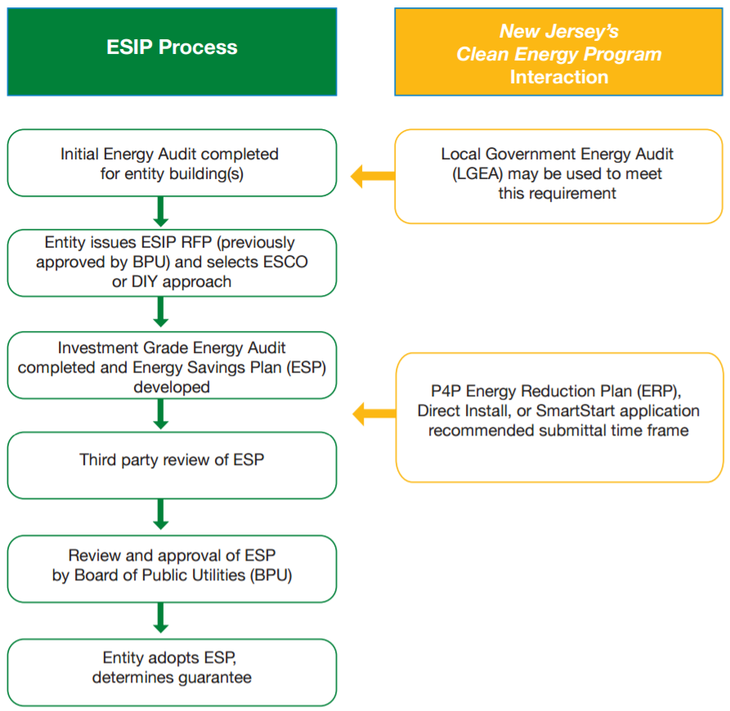
Energy Savings Improvement Program (ESIP)

Slide 10
(Small Business) Direct Install
Easy retrofits for Main Street/Mom & Pops
Target small-medium sized facilities
Less than 200 kW peak demand
Free energy assessment
  Replace lighting, HVAC equipment, outdated operational equipment with energy efficient alternatives
Pays up to 70% of retrofit costs
Energy savings through monthly utility bills
Installation completed within 90 days of energy assessment

Slide 11
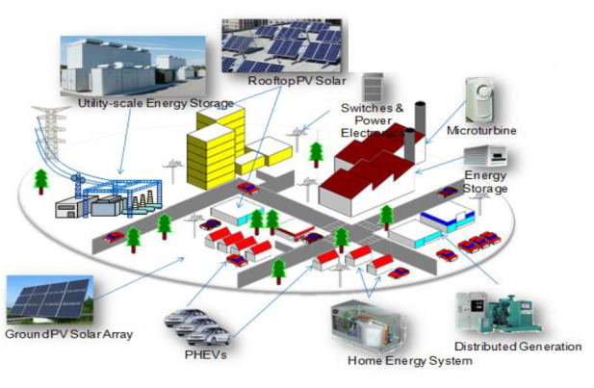
On-Site Generation and Energy Resilience
Combined Heat & Power CHP/Cogeneration Program
Town Center Microgrid Initiative
Renewable Electric Storage Program
Energy Resilience Bank

Slide 12
CHP Program
Eligible Technology | Size (Installed Rated Capacity) | Incentive ($/kW) | % of Total Cost Cap/project | $ Cap/ project
Powered by non-renewable or renewable fuel source | ≤ 500 kW | $2,000 | 30-40% | $2 million
Gas Internal Combustion Engine | >500 kW – 1 MW | $1,000 | 30% | $3 million
Gas Combustion Turbine | > 1MW – 3MW | $550
Microturbine | > 3MW | $350
Fuel Cells with Heat Recovery
Waste Heat to Power | < 1 MW | $1,000 | 30% | $2 million
 | > 1 MW | $500 |  | $3 million

Slide 13
Town Center Microgrid Initiative
Operate as a shelter during/after emergencies
  Multifamily buildings, hospitals, local/state government operations, etc.
Operate while isolated and “islanded” from grid
Facility must be served by a regulated utility that collects societal benefits
5-12 grants for feasibility studies from a $1M budget
  Grants up to $200,000 available per facility
Following completion of study the winners will move into engineering design phase

Slide 14
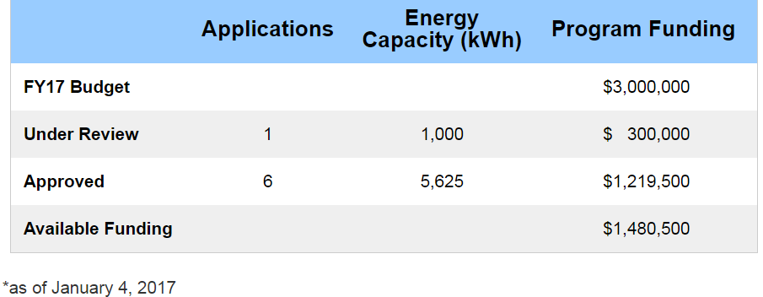
Renewable Electric Storage Program
$3 million budget – FY 2017 (ends June 30, 2017)
Integrated storage and renewable energy behind the meter (non-residential only)
Goal is to encourage peak shaving/load shifting and emergency backup for essential services
$300/kW, max of $300,000 per project or 30% of project

Slide 15
Energy Resilience Bank (ERB)
NO LONGER ACCEPTING APPLICATIONS
For public and/or not-for-profit applicants, ERB provide 100% of the project’s unmet need as
  a grant/forgivable loan (not to exceed $25 million) for all eligible Resilient Costs
  a grant/forgivable loan equal to 40% of the remaining eligible project costs
  an amortizing, 2% interest rate loan with a term up to 20 years, for the balance of ERB project funding
Operate isolated from electric grid (islanding)
Start up without direct connection to the grid (blackstart)
Remain operational during future outages at critical load
Must demonstrate impact by Sandy or other extreme weather event by:
  Physical damage to the facility
  Indirect impact by supporting revitalization of the community

Slide 16


Additional Programs and Incentives
Local Government Energy Audit – 100% cost covered
Large Energy Users - $4 million cap, up to 75% project cost
Residential Programs - various
Refrigerator/Freezer Recycling Program
Solar Renewable Energy Credit (SREC)

Slide 17
Solar Renewable Energy Credit (SREC)
SREC earned when 1,000 kWh is generated
SREC’s can be sold for first 15 years of project’s life
SREC’s purchased by electricity suppliers
SREC’s are sold separately from the electricity they produce
Selling price is determined by market supply and demand mechanics
  EY2016 average SREC price is $200

Slide 18
Questions

