Slide 1
PECO Smart Ideas for Your Business

Slide 2
Agenda
PA Act 129 Phase III Overview
PECO Smart Ideas for Your Business
    Commercial & Industrial Solutions
    Multifamily Solutions
    Small Business Solutions
PECO Smart Ideas Trade Allies

Slide 3
PA Act 129, Phase III

Slide 4
Act 129 Phase III
Solutions designed to achieve energy efficiency
Help customers adopt energy efficient solutions
Embed energy efficiency into mindset of industry
Reduce excess energy consumption
Decrease customers’ overhead costs
Divided into three phases
    Phase I: June 1, 2009 - May 31, 2013
    Phase II June 1, 2013 - May 31, 2016
    Phase III: June 1, 2016 - May 31, 2021

Slide 5
Act 129 Goals
Phase II
3 Year Program cycle
1,125,550 MWh reduction requirement
10% target reductions from GNI sector
No Demand Reduction target
Phase III
5 Year Program cycle
1,962,659 MWh reduction requirement
3.5% target reductions from GNI sector
161 MW Demand Reduction target

Slide 6
Benefits of Energy Efficiency
Reduce facility’s operating costs
Eliminate energy waste
    Almost 30% of energy consumed by buildings is used inefficiently or unnecessarily
Create a comfortable and safe environment for employees, customers, and guests
Demonstrate environmental stewardship by reducing energy use and greenhouse gas emissions
Notes:
*energystar.gov/buildings/about-us/facts-and-stats

Slide 7



PECO Smart Ideas for Your Business

Slide 8
PECO Smart Ideas Overview
A suite of nine residential and seven business programs offering solutions for energy efficiency
Customer-centric portfolio of energy solutions
    Solutions cross every sector from commercial and industrial from nonprofits and government to retail and real estate
    Includes whole building systems and new construction
    Incentives designed to influence customer decisions
    Offset the incremental capital cost of selecting more energy efficient solutions
Motivate customers to chose higher efficiency products, equipment and processes

Slide 9

PECO Smart Ideas Accomplishments
Since June 2009, more than:
    $500 million saved by customers through PECO Smart Ideas
    2.2 billion kilowatt hours of electricity saved through energy efficiency actions
    8,000 incentives earned by non-residential (business) customers
    58,000 rebates provided to customers for recycling older, working appliances
Environmental benefits savings equal to:
    Reducing vehicle emissions produced by more than 267,000 passenger vehicles
    Planting more than 2.3 million trees
    Eliminating 2.4 billion miles driven
PECO named ENERGY STAR® Partner of the Year
four times

Slide 10
New in Phase III
Phase II:
Smart Equipment Incentives (C&I)
Smart Equipment Incentives (GNI)
Smart Construction Incentives
Smart Business Solutions
Smart Multifamily Solutions
Phase III:
Commercial & Industrial Solutions (includes new construction and GNI)
Multifamily Solutions
Small Business Solutions

Slide 11

PECO Smart Ideas for Your Business Solutions
PECO Smart Ideas offers incentives whether you’re looking to reduce operating costs, construct a new facility or planning a major renovation.
Commercial and Industrial Solutions
    Data centers, small and large commercial and industrial businesses, municipalities, schools, assisted living facilities, and more!
  Multifamily Solutions
    Condo and apartment buildings with three or more units
    Master metered and residential metered properties
Small Business Solutions
    Restaurants, bars, convenience and grocery stores, drug and liquor stores, etc.

Slide 12


Commercial and Industrial Solutions

Slide 13


Commercial and Industrial Solutions Overview
    Incentives for energy efficient heating and cooling systems, refrigeration equipment, lighting, variable frequency drives, and custom measures
  All non-residential customers are eligible for all incentives
  Project must provide a reduction in annual kWh usage

Slide 14
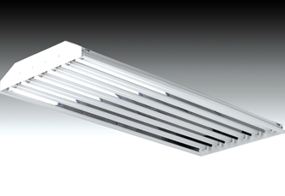
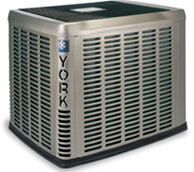
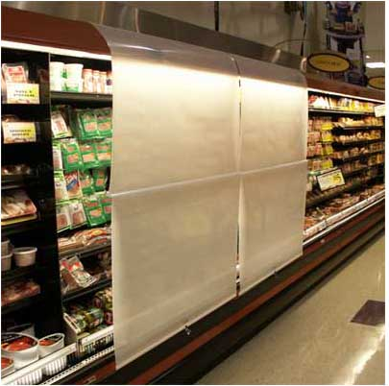
Prescriptive Measures
Fixed incentive per unit
  HVAC equipment/sensors and controls
  Unitary chillers
  ENERGY STAR refrigeration and cooking equipment
  Food service
  Motors and VFD drives
  Heat pump water heaters
  Compressed air storage tanks
  Data center CRAC & CRAH units
  Lighting and controls
    Interior/exterior and traffic signals
    Per lamp/fixture or sign
  New construction interior lighting
  Whole building systems

Slide 15
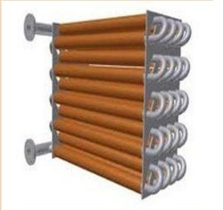
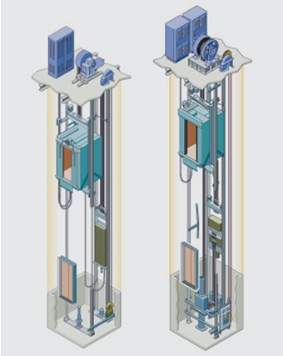
Custom Measures
Non-prescriptive measures that require demonstration of energy savings, such as:
    Non-unitary chillers
    Free cooling
    PC power management, smart plugs, plug load management
    Building envelope - white/green roof, windows, air sealing, weather-stripping
    Process cooling - mushroom farming, manufacturing
    Process upgrades - HEPA filtration, aeration, new equipment
    Compressed Air supply measures
    ENERGY STAR office equipment
  Incentives paid per annual kWh saved in the first year of operation
    Eligibility determined on a case-by-case basis
    Provide the methods used to determine estimate
    Pre and post metering may be required
    Submit a savings estimate and program staff will evaluate to determine final kWh savings

Slide 16
Start Saving Today
Call the PECO Smart Ideas team at 1-844-4BIZ-SAVE (1-844-424-9728) or, email pecosmartideas@dnvgl.com.
We’ll help you:
Evaluate your energy efficiency opportunities
Apply for your incentives
Enjoy all the benefits of energy efficiency!
Choose qualifying equipment and measures

Slide 17

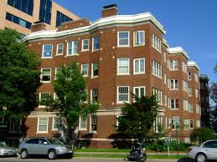
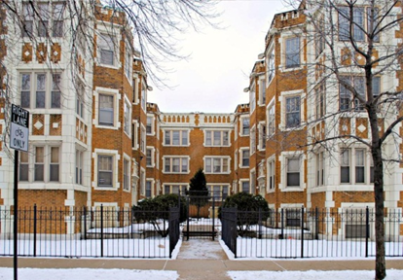
Multifamily Solutions

Slide 18
Multifamily Solutions Overview
Energy savings for multifamily property owners and tenants
  Buildings with two or more units
  Includes master-metered and residentially metered properties
Participation channels
  Residential unit occupants receive benefits through participation by building management – CFLs, high-efficiency shower heads*, faucet aerators*
    Free direct install (DI) of low-cost measures
  Property managers receive a free energy assessment for common areas including a report of potential energy saving upgrades for their facility
    Prescriptive incentives for installation of high-efficiency equipment that address common areas or whole building improvements
* Electric hot water heating only

Slide 19


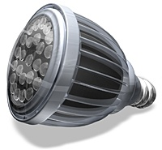
Direct Install
Free installation of CFL’s and LED’s replacing incandescent bulbs
If domestic water heat is electric
    High-efficiency showerheads
    Kitchen and bathroom aerators

Slide 20
Energy Assessment
Free assessment of common area and whole building systems
Goal to identify prescriptive and DI projects
Capture inventory of additional energy savings opportunities
Focus on common area lighting and electrically powered mechanical systems
Inspect sample tenant spaces to estimate DI requirements
Provide assessment report detailing estimated energy savings potential and estimated prescriptive incentives from PECO

Slide 21
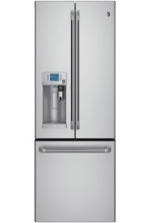
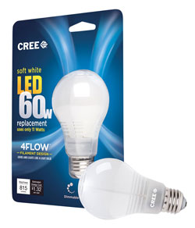
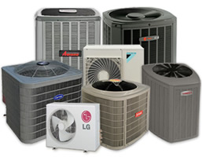
Prescriptive Incentives
Measures for Common Areas include:
Interior Lighting*
Fluorescent Fixtures
LED Fixtures
CFL Lamps
LED Lamps
Exterior and Garage Lighting*
T5 or HPT8 Fixtures (electronic ballasts)
LED Fixtures
Exterior and Garage Induction Fixtures
Occupancy Sensors
Domestic Hot Water Heating
HVAC
Air Sourced Air Conditioner
Air Cooled Chiller
PTAC
Economizers
Motors
ECM Circulation Fans and Pumps

Slide 22
Start Saving Today
Call the PECO Smart Ideas team at 1-844-4BIZ-SAVE (1-844-424-9728) or email pecosmartideas@franklinenergy.com.
We’ll help you:
Request free energy assessment
Get rewarded with incentives on qualified projects
Enjoy all the benefits of energy efficiency!
Receive in-unit product installation

Slide 23
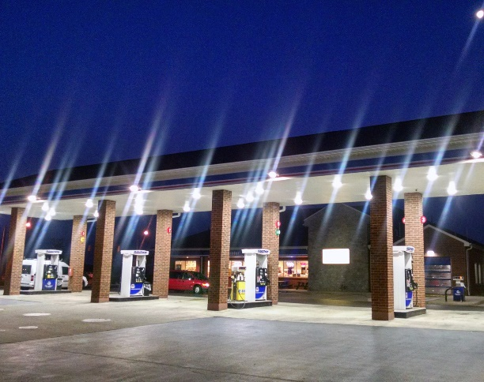
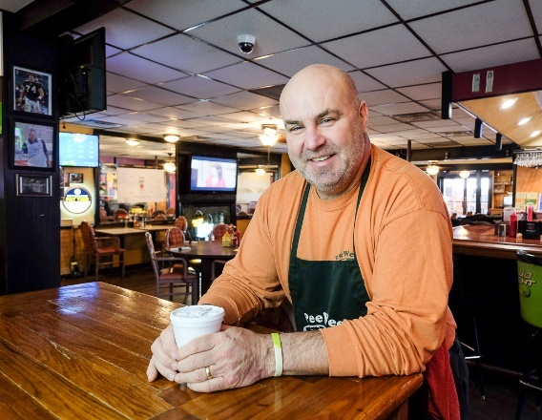

Small Business Solutions

Slide 24
Small Business Solutions Overview
Direct installation of energy saving measures
  Small business customers with peak demand less than 100 kW
  Target: Restaurants, bars, gas and convenience stores, grocery, drug, and liquor stores
  Includes eligible lighting, refrigeration and electric hot water measures
Solution providers offering:
  Interest free financing
  Discounts for payment in full
Program promoted directly to small business owners

Slide 25
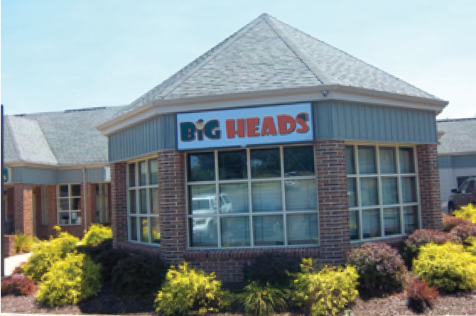
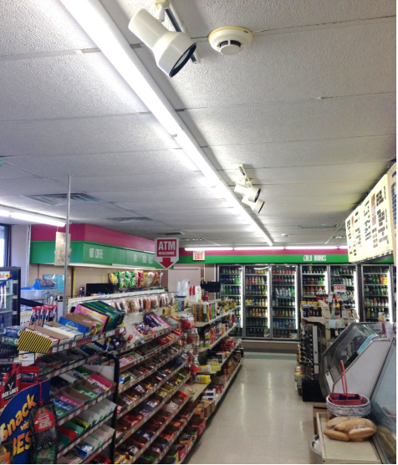
Success Stories
Big Head’s Pub
  Lighting and refrigeration system upgrades
  Annual Energy Savings: 189,884 kWh
  Annual Energy Cost Savings: $22,843
  PECO Incentive: $32,876
Maple Deli
Lighting upgrades and lighting controls installation
  Annual Energy Savings: 15,682 kWh
  Annual Energy Cost Savings: $1,884
  PECO Incentive: $2,808

Slide 26
Start Saving Today
Call the PECO Smart Ideas team at 1-844-4BIZ-SAVE (1-844-424-9728) or email pecosmartideas@smartwattinc.com.
We’ll help you:
Schedule your free comprehensive on-site energy analysis
Receive incentives on qualified projects and direct install
Enjoy all the benefits of energy efficiency
Get your free energy analysis report and project proposal

Slide 27

PECO Smart Ideas Trade Allies

Slide 28
Trade Ally Program Benefits
For Customers…
  Enhance business operations and occupant comfort
  Reduce risk, improve safety
  Lower O&M costs
  Improve financials: ROI, SIR, life cycle cost analysis
  Enhance controls: demand management
  Achieve sustainability goals
  Improve aesthetics and building value
For Trade Allies and Contractors…
  Additional business - savings rollover to more projects
  Penetrate market with energy-efficient solutions
  Improve service levels, build customer loyalty

Slide 29
Trade Allies
Industry Service Providers:
    HVAC
    Motors/Pumps/Drives
    Refrigeration and Food Services
    Building Automation
    Compressed Air
    Lighting/Lighting Controls
    Certified New Construction
    Building Shell/Envelope
    Process Automation
    Data Center
    Rebate Processing
    Water Treatment
    Water Heating
    Energy Audits
    ESCOs (Energy Service Companies)
    Financing
    Commissioning/Retro-Commissioning

Slide 30
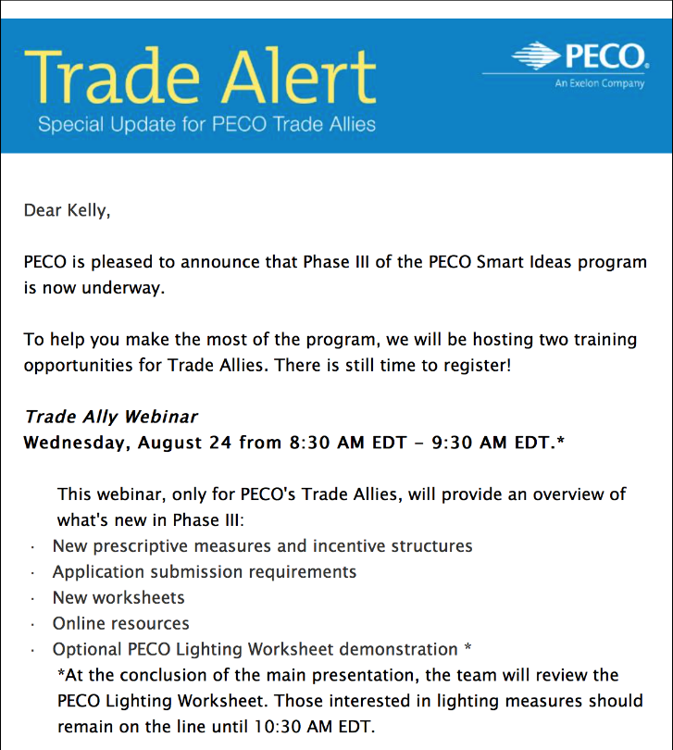
Trade Ally Program Overview
  Leverage PECO Smart Ideas to grow business
  Exclusive access to training and education
  Listing on the PECO website and through the Call Center
  Access to marketing materials, special promotions and offers
  Newsletters and alerts
  Trade Ally networking and events
  Assigned outreach personnel

Slide 31
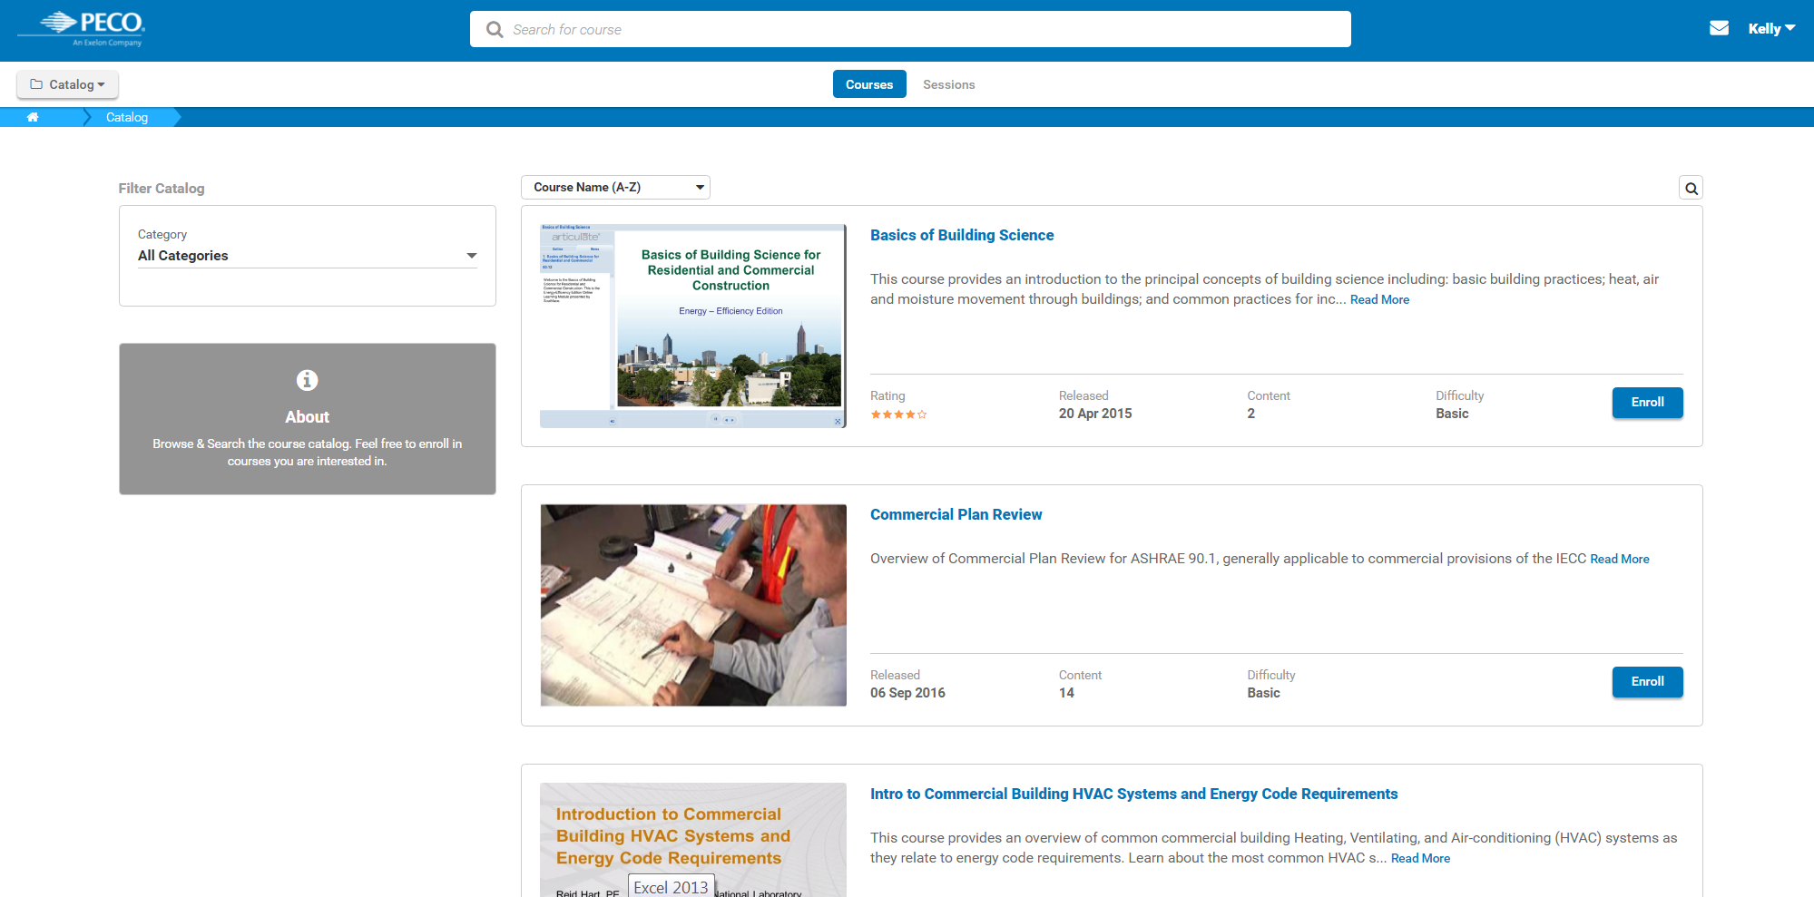
Contractor Learning Center

Slide 32
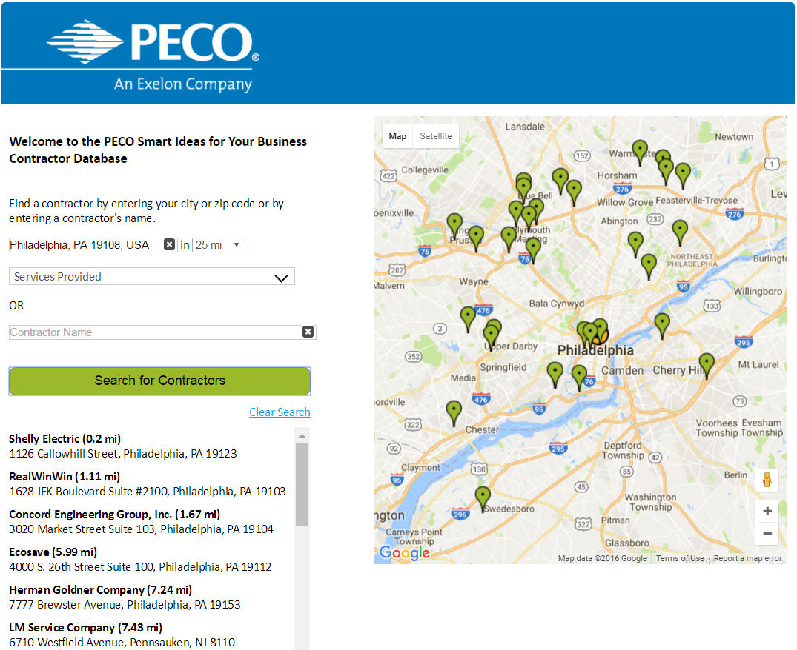
Find a Trade Ally
Sample Company 1 (0.5 mi)
111 Sample A Street, Philadelphia, PA 19000
Sample Company 2 (1.00 mi)
222 Sample B Street, Philadelphia, PA 19000
Sample Company 3 (5.00 mi)
333 Sample C Street, Philadelphia, PA 19000
Sample Company 4 (10.00 mi)
444 Sample D Street, Philadelphia, PA 19000

Slide 33
Become a Trade Ally
Call the PECO Smart Ideas team at 1-844-4BIZ-SAVE (1-844-424-9728) or email pecosmartideas@dnvgl.com.
We’ll help you:
Complete and Sign Trade Ally Application
Submit a minimum of one project application every 12 months
Take advantage of promotional opportunities and grow your business!
Attend at least one recognized training each year

Slide 34
Thank You!

