Slide 1

A New (Rational) Way
To Condition Air
(and Save Energy)
AEE, Philadelphia
February 18th 2016
Andrew Mongar, President, AirGreen LLC
Notes:
Good afternoon! Thank you for the introduction.
100 years ago on June 26th 1915 Willis Carrier and some friends formed the Carrier Engineering Corporation. The main motivation of his air conditioning method at the time was to control humidity.
I am going to present a new method of controlling both humidity and temperature that saves energy and cost overall.
Dr. Charles Bullock, a retired Carrier Fellow, used to say “Sadly we do only cooling not full air conditioning.”

Slide 2
Why Change? – The Problems
Cost of handling humidity is very high Need to cool to below the dew-point to remove moisture and reheat
Buildings are uncomfortable – cold and 60+%RH
Buildings have high latent (humidity) loads because sensible has been reduced by increased standards
Ventilation air is needed but it is humid
Cold buildings cost more to cool than comfortable ones
Conventional HVAC needs to be changed
Notes:
The problem is that conventional Direct Expansion (DX) systems using cold coils to condense moisture do not remove humidity efficiently and can do only 20% latent energy.
This limit on the ability to remove humidity leaves buildings damp and also cold in the attempt to remove humidity. Cold buildings are more expensive to cool.
The ratio of latent heat (humidity) to sensible heat (temperature) risen because sensible heat loads have fallen with better insulation and more efficient lighting, but the humidity from ventilation air and occupants has stayed about the same.

Slide 3
8 More Problems with Current HVAC
Air conditioning uses about 40% of energy in buildings
Current technology cannot control humidity effectively or economically
Health and comfort suffer because current products cannot control humidity
Existing systems deteriorate and necessary maintenance is often not done
First cost of good systems is high and they take up much space
Ventilation loads at peak times cannot be met and IAQ suffers
Existing systems do not clean the air but circulate contaminants
Over-cooling and reheating is an unsustainable use of energy
Notes:
The list of problems with existing systems goes on. The purpose of air conditioning is not just to cool – It is to create comfortable conditions.

Slide 4
Comfort and Health Conditions
Air conditioning must perform four basic functions (ASHRAE):
1) control temperature; 2) control humidity; 3) control air circulation and ventilation; 4) cleanse the air.
Maximum comfort is at 78 to 80ºF
Relative Humidity should be 35 to 50% [conventional systems deliver 60+% RH]
Ventilation air should be conditioned all year round to room conditions and meet ASHRAE 62
Recirculated air should be cleaned not just filtered, which does very little to fine particulates and nothing to microbes
Notes:
Comfort and health are the main purpose of air conditioning. As Dr Bullock said “We do not condition air” and he was speaking for the HVAC industry in general.
Most buildings – even high quality offices – do not meet ASHRAE 62.2 mandated ventilation volumes on a really bad day. The ventilation air volume is reduced on such days because the HVAC system cannot deal with the humidity load adequately.
Much of the humidity comes from the Outside Air. Outside Air volumes in schools were recently reported by a government study to be only 40% on average of the mandated levels.
Hospitals require relatively high levels of Outside Air. Hospitals also require low humidity air especially in operating rooms to reduce infection risk, and cleaned and sterilzed.

Slide 5
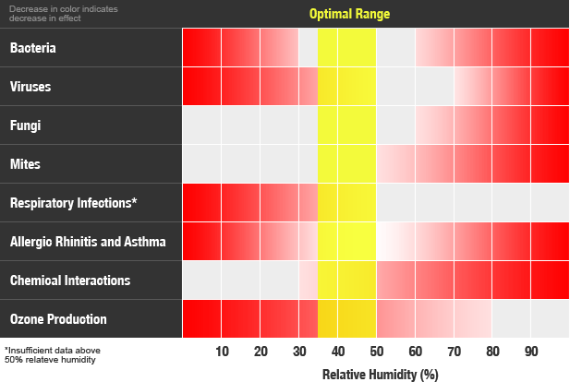
Notes:
Many people believe that “air conditioning makes them sick”. Well! That is not accurate. Bacteria, viruses and pollutants make them sick, but a normal HVAC system produces an unhealthy humidity level and does not remove pollutants or microbes.
The Sterling Chart (ASHRAE, 1985) shows that the relative humidity should be between 35 and 50% for health reasons.

Slide 6
The Nub of the Problem
Conventional systems cannot handle more than 25% humidity and struggle to cool and dehumidify
As buildings have become better insulated less cooling is needed but the same humidity removal, or more
Humidity loads including ventilation are now often more than 50% of total enthalpy load
Result:
Ever more complex systems of control that do not meet all conditions, are difficult to use, and still use far too much energy. The only (partial) solution offered is the desiccant wheel.
Notes:
Better insulation and efficient lighting mean that the Outside Air load is a greater proportion of the total. This also means that the latent load is a greater proportion of the total load. The Sensible Heat Ratio falls well below the 80% level.
Climate change has resulted in humidity design conditions are being exceeded even more frequently than temperature design conditions.
Few technology innovations address the need to control humidity effectively and economically. Conventional systems have veered towards VAV and VRF. There are hot gas bypass and heat pipes. So-called “high-efficiency air conditioners” do not solve the humidity problem nor significantly improve energy efficiency at peak demand.

Slide 7
Desiccant Cooling
Solid or liquid desiccants remove moisture without over-cooling
The desiccant must be regenerated by applying dry, heated air
Solid desiccants require relatively high temperature air
Liquid desiccants can be moved through a heat exchanger
Multi-stage Third Generation (3G) liquid desiccant processes use the least and lowest cost energy for humidity removal and for regeneration
Notes:
A better A/C system would be designed to remove humidity in an energy efficient way.
Desiccant processes until now have been either inefficient or have required high temperatures to regenerate the desiccant. This means they do not match well with compressors as the cooling source.
The 3rd Generation Liquid Desiccant process I am going to describe can use water-based heat pumps or refrigerant direct compressors as energy sources, or renewable sources.

Slide 8
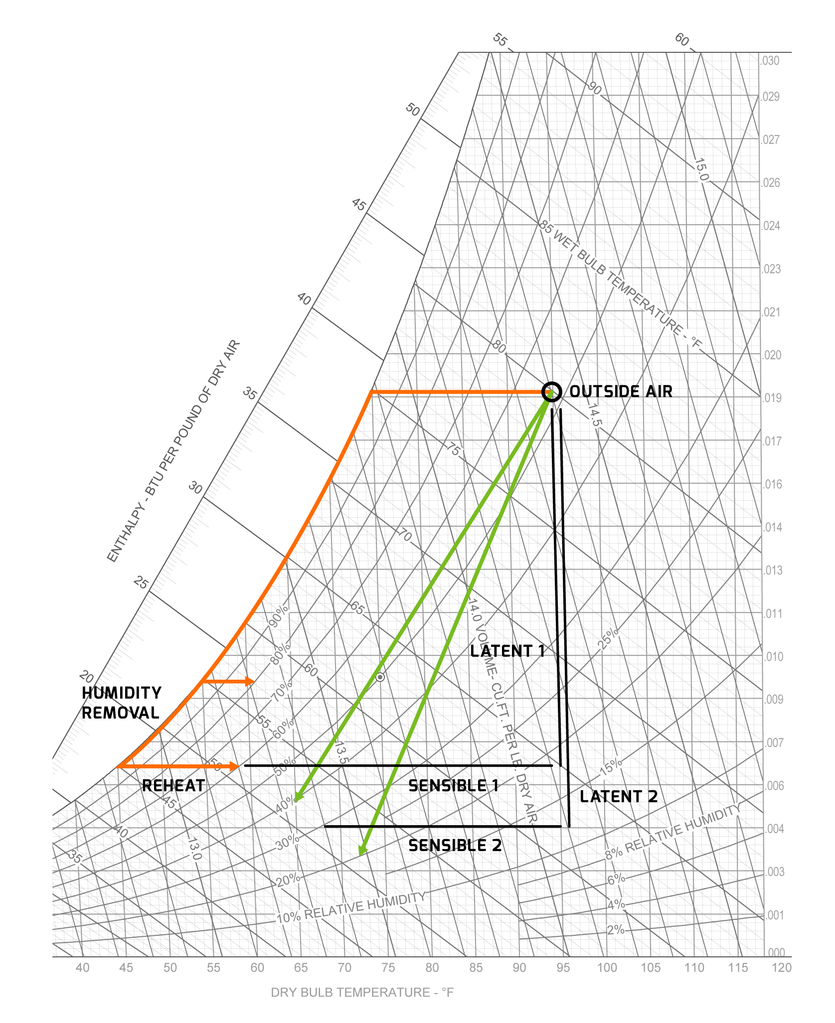
Conventional vs
3G Desiccant
Notes:
I define a Third Generation (3G) Liquid Desiccant system as one that removes combined latent and sensible energy as required. It provides both dehumidification and cooling without using wet coils. Conventional systems cool to the dewpoint and then try to remove moisture down the saturation line. The air should then be reheated. Desiccant systems go straight to the comfort condition and you have a choice about exactly what that is.
[For the technically minded, on this psychrometric chart the orange line shows the conventional cooling of Outside Air followed by more cooling down the saturation line. Most air conditioners cool to 55F and deliver air directly to the space – cold and damp. “Better quality” systems cool further to around 45F removing more moisture and then reheat to around 60F. The reheating need not be expensive. What is costly is that it is undoing the expensive deep cooling that is needed only to remove humidity.
The green lines show third generation liquid desiccant technology. Only the necessary enthalpy reduction is carried out. All the energy used is usefully employed in removing unwanted enthalpy. The user has a choice about the range of conditions supplied and achieved in the space.]
Note that the conventional system(1) needs to remove nearly equal latent and sensible energy removed and the 3G system (2) removes considerably more latent energy than sensible.

Slide 9
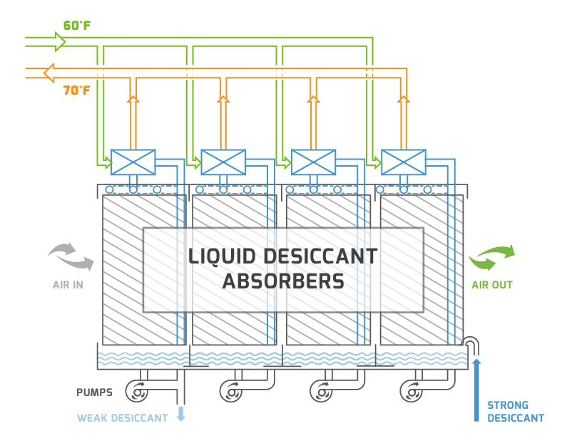
Multi-Stage Liquid Desiccant System
1. Air Conditioner
Moisture removed on several absorbers by liquid desiccant
Liquid desiccant pumped through plate heat exchangers with cooling fluid to remove latent heat at each stage
Air delivered dry (controlled) and cooled
Notes:
One such Third Generation Liquid Desiccant system is a multi-stage process recently patent pending. The heart of the Multi-Stage LD system is a series of desiccant absorbers. Four are shown. At each stage the desiccant is pumped from a sump to wet the absorber pad. The air flows over the pad and the liquid desiccant absorbs moisture and gives out latent heat. The desiccant is pumped through a plate heat exchanger and is cooled by an external source. Water, glycol or refrigerant may be used as the cooling fluid.
Cooling the desiccant at each stage makes it more effective at removing moisture from the air.
The desiccant flows through the device at a controlled rate countercurrent to the air and exits in a diluted state for regeneration.
The system has been independently tested using 60F water.

Slide 10
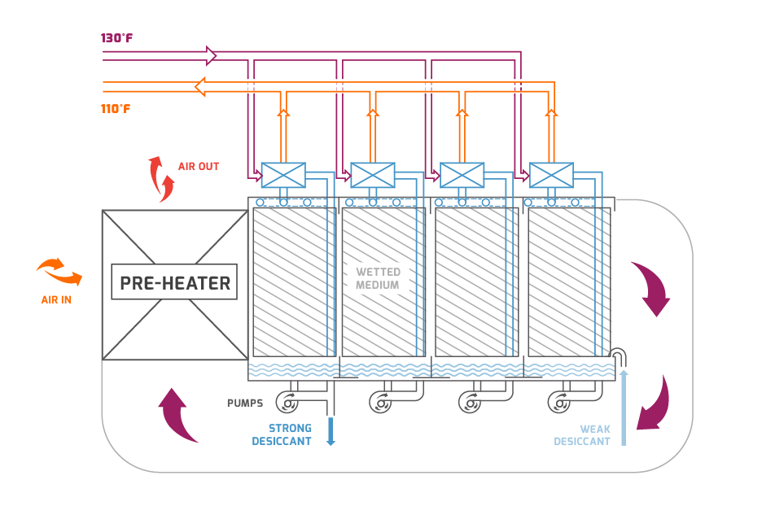
Multi-Stage Liquid Desiccant System
2. Regenerator
Same apparatus but using return air and a heating fluid instead of cooling
Notes:
This apparatus is almost the same as the air conditioner. The desiccant regenerator reconcentrates the liquid desiccant so that it can be reused. It is the same apparatus but with an optional air-to-air heat exchanger to preheat the air. The regenerator is fed with a heating fluid instead of a cooling fluid and the air is the exhaust air from the building to recapture the energy used to cool it.
With a compressor, the regenerator is acting like the condenser coil in a compressor-based system and replaces 70% of the condenser coils.
This design has been tested and shown to be effective for typical building requirements with a heating fluid at 130F or less.

Slide 11
What is Revolutionary?
The ability to handle any amount of humidity using only 60 or 65F to remove latent heat
The ability to regenerate the desiccant using waste heat at only 125 or 130F
More than 95% effectiveness of using the thermal energy from a compressor OR renewable/waste energy system
Leading edge technology solves all the problems associated with mainstream HVAC products
Made in the USA
Notes:
This system can control the air temperature and humidity independently. It uses mild cooling and heating temperatures and so can be more efficient. 60F and 130F are revolutionary temperatures that can be achieved with the multistage process.
The effectiveness of the cooling and heat use is over 95% even off-peak. It can use any source of heat and cooling (such as groundsource).
It solves all the 13 problems I listed earlier. The equipment is made here in the USA.

Slide 12
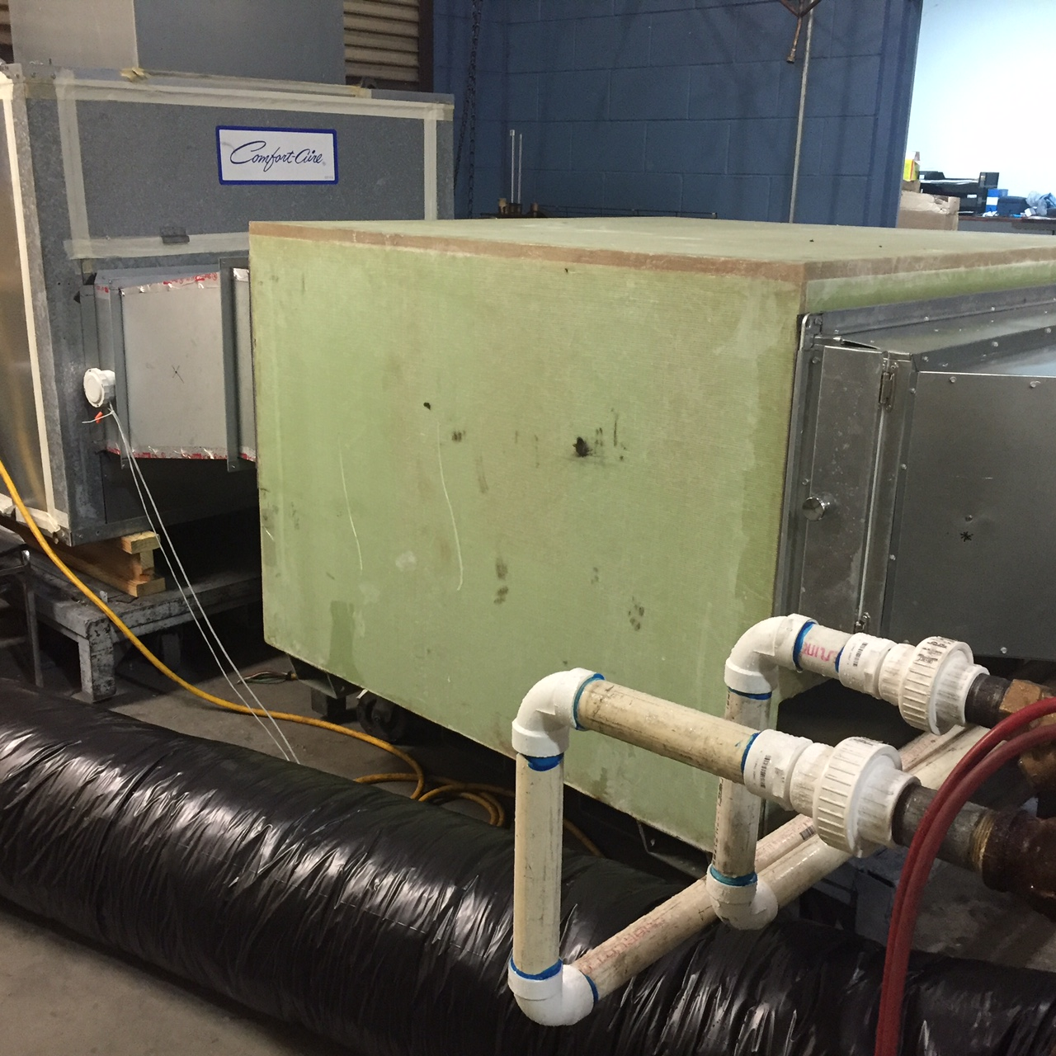
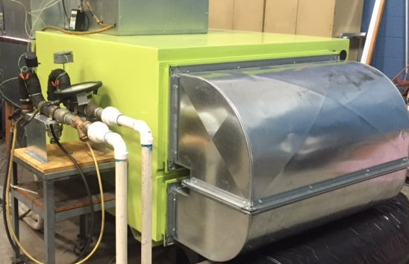
Beta Unit Under Test – October 2015
Air Conditioner
Regenerator
Notes:
This is the first of the Beta units on test at an independent facility.
At 2,000 cfm the unit had a capacity of 15 tons – far higher than most systems.
The cold and hot water pipes are shown.

Slide 13
The Result – Rational HVAC
Energy savings of 40 to 60+% with better comfort
Compressor capacity reduced 40 to 50%
Condenser coils reduced by 70%
Lower indoor air-flow volumes; less fan energy
Control of RH independently of temperature
Control of ventilation air all year round with enthalpy recovery and cleaned air
Andrew Mongar, President, AirGreen LLC 610-209-8067 www.airgreenllc.com
Notes:
The system described is a rational use of energy:
The 3G LD system removes humidity efficiently and saves on average 60% of energy. It uses compressors more efficiently, and at a capital cost no more than conventional systems and with lower air flow.
It controls humidity effectively and independently of temperature. It enables the supply of ventilation air even at high latent loads with lower energy consumption. It can be used almost every HVAC application with conventional compressors or with renewable energy.
The plan is to make and test field trial units this year and launch a commercial product next year.
THANK YOU. ANY QUESTIONS?

