Slide 1

PECO Smart Ideas for Your Business
Greater Philadelphia Association of Energy Engineers
Mike O’Leary, PECO
April 20, 2016

Slide 2
PA Act 129 Phase II – PECO Smart Ideas
A suite of nine residential and seven business programs offering solutions for energy efficiency
Incentives designed to influence customer decisions
  Motivate customers to chose higher efficiency products, equipment and processes
  Offset the incremental capital cost of selecting more energy efficient solutions
Phase II ends on May 31, 2016, Phase III
begins on June 1, 2016
Notes:
2

Slide 3
Smart Ideas Program Accomplishments
Since June 2009, more than:
  $500 million saved by customers through PECO Smart Ideas
  2.2 million megawatts hours of electricity saved through energy efficiency actions
  8,000 incentives earned by non-residential (business) customers
  58,000 rebates provided to customers for recycling older, working appliances
Environmental Benefits, savings equal to:
  Reducing vehicle emissions produced by more than 267,000 passenger vehicles
  Planting more than 2.3 million trees
  Eliminating 2.4 billion miles driven
PECO named ENERGY STAR® Partner of the Year four times
Notes:
3

Slide 4
Act 129 - Phase II vs Phase III
Phase II:
3 Year Program cycle
1,125,550 MWh reduction requirement
$256 M Total Budget
10% target reductions from GNI sector
No Demand Reduction target
Phase III:
5 Year Program cycle
1,962,659 MWh reduction requirement
$428 M Total Budget
3.5% target reductions from GNI sector
161 MW Demand Reduction target
Notes:
4

Slide 5
Phase II vs Phase III EE Programs
Phase II:
PECO Smart Equipment Incentives (C&I)
PECO Smart Equipment Incentives (GNI)
PECO Smart Construction Incentives
PECO Smart Business Solutions
PECO Smart Multifamily Solutions
PECO Smart On-Site
Phase III:
PECO Smart Equipment Incentives – Small
PECO Smart Equipment Incentives – Large
PECO Smart Business Solutions
PECO Smart Multifamily Solutions
PECO Smart On-Site
Notes:
5

Slide 6

PECO Smart Equipment Incentives - Small
Eligibility: PECO Rate GS, TLCL, AL, SL-S, SL-E customers
$11.9M incentives for energy efficient retrofits or new construction projects
  Commercial and Industrial (C&I)
  Government, Non-profit and Institutions (GNI)
Broad range of prescriptive incentives for most energy efficient upgrades
Custom incentives available for qualifying upgrades
Messaging and outreach specifically designed to reach this class of customer
Notes:
6

Slide 7
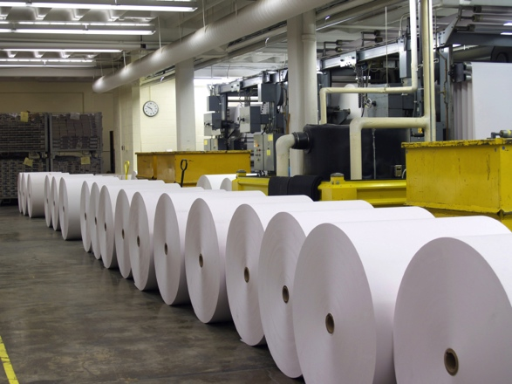
PECO Smart Equipment Incentives - Large
Eligibility: PECO Rate HT, PD, EP customers
$26.2M incentives for energy efficient retrofits or new construction projects
  Commercial and Industrial (C&I)
  Government, Non-profit and Institutions (GNI)
Prescriptive and custom incentives available for HVAC, Drives, Refrigeration, Lighting, Compressed Air, etc.
Outreach Team and PECO Account Managers will work closely with customers, developers and trade allies to identify and cultivate projects
Notes:
7

Slide 8

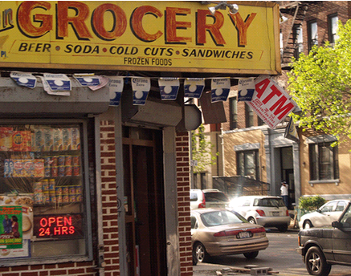

PECO Smart Business Solutions
Direct installation of energy saving measures
  Small business customers with peak demand less than 100 kW
  Target: neighborhood shops, corner grocery stores
  Available to C&I and GNI customers
  Incentives cover up to 50-60% or more of direct installation costs
  Includes eligible lighting, refrigeration and electric hot water measures
Program Administrator is offering:
  Interest free financing
  Discounts for payment in full
Program promoted directly to
  small business owners
Notes:
8
Add the numbers… key metrics missing the face to face interaction direct install outreach…

Slide 9
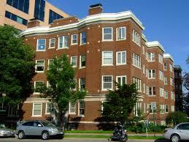
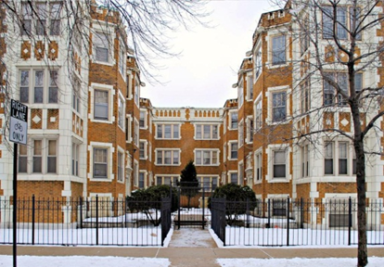
PECO Smart Multifamily Solutions
Energy savings for multifamily property owners and tenants
  Buildings with four or more units
  Includes master-metered and residentially metered properties
  C&I and GNI properties are eligible
  Program marketed directly to building management
Free direct install of low-cost measures for multifamily residents
Free energy assessment for common areas including a report of potential energy-saving upgrades
  Prescriptive incentives for installation of high-efficiency equipment that address common areas or whole building improvements
Notes:
9

Slide 10
PECO Smart On-Site
Incentives for customers installing combined heat and power (CHP) systems
Tiered incentive structure distributed at key milestones in the design and construction process
  Design incentive
  Capacity incentive (TBD)
  Performance incentive (TBD)
  Max total incentive is 50% of project cost up to a maximum (TBD)
Program delivery method under development
Notes:
10

Slide 11
General Program Rules
Projects previously completed are not eligible for incentives
Pre-applications are required before funds will be reserved
Pre- and post inspections may be required
Renewable energy resources are excluded from the programs
Projects focused primarily on power factor improvement are not eligible for incentives
Incentives cannot exceed 100% of total project cost
Lighting baseline changes will be in effect

Slide 12

Tools for Business Customers
PECO Smart Business E-Audit
  Designed for small businesses
  On-line tool providing a detailed report on energy use
  Tips for no-cost and low-cost improvements to save energy
  peco.com/SmartIdeas
PECO Smart Energy Usage Data Tool
  Developed to help benchmark commercial building energy use
  Once set-up allows customers to export data into Portfolio Manager
  peco.com/SmartIdeas
ENERGY STAR Portfolio Manager
  On-line tool to track and measure energy use
  Benchmark individual commercial buildings or entire portfolios
  energystar.gov
Notes:
12

Slide 13

Resources for Business Customers
Database of State Incentives for Renewables and Efficiency
  dsireusa.org
U.S. Department of Energy
  energy.gov
Pennsylvania Green Energy Loan Fund
  For energy efficiency projects throughout PA
  tTrfund.com
EnergyWorks Loan Fund
  For energy efficiency projects in SE PA
  energyworksnow.com
Notes:
13

Slide 14
~ QUESTIONS ~
1-888-5-PECO-SAVE (1-888-573-2672)
peco.com/SmartIdeas
SmartIdeasBiz@peco-energy.com

