Slide 1
Association of Energy Engineers
Randy Haines, CEM, CLEP, CMVP
Energy Manager, Jefferson
April 20, 2016

Slide 2
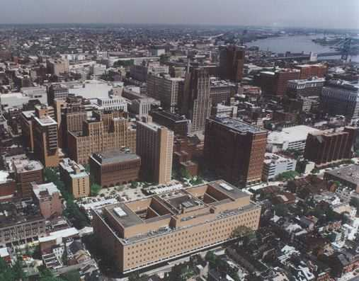

Slide 3
A little background for Jefferson
Teaching Hospital and University in Center City founded in 1825.
More than 4 million square feet and 14,000 employees
Electrical peak is 21 megawatts
Consume more than 130,000,000 kWh per year
One third of our electricity comes from a PA. wind farm
Started an Energy Program in 1999, have saved more than $123 Million
Have installed more than $18 M in new energy saving equipment.
Just underway on a new group of energy projects for $10.6M

Slide 4
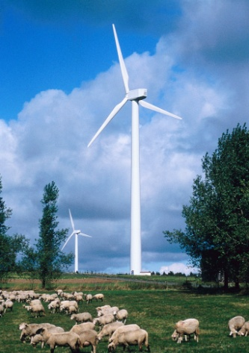

Slide 5
FY 15/16 Energy Budget, Total $21.3M

Slide 6
Energy Efficiency rates and costs to Jefferson
Program Year (June 1- May 31) | EEPC $/kw-PLC | Total cost
Phase I, 2010-2013 | $0.91 | $750,000.00
Phase II, 2013-2016 | $0.79 | $500,000.00
Phase III, 2016-2017 (no DR) | $0.60
Phase III, 2017-2018 | $1.05
Phase III, 2018-2019 | $1.06
Phase III, 2019-2020 | $1.06
Phase III, 2020-2021 | $0.98 | $1,250,000.00
Total Cost |  | $2,500,000.00

Slide 7
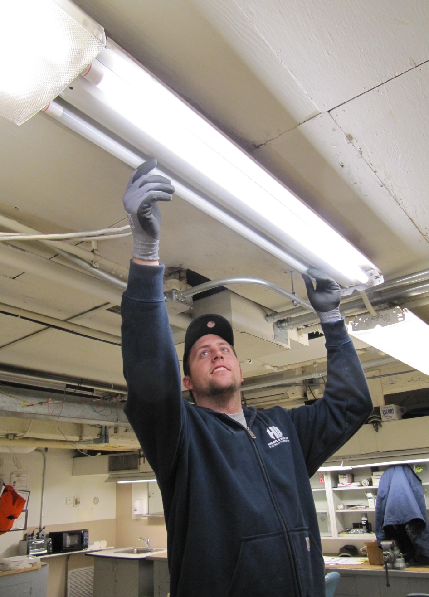
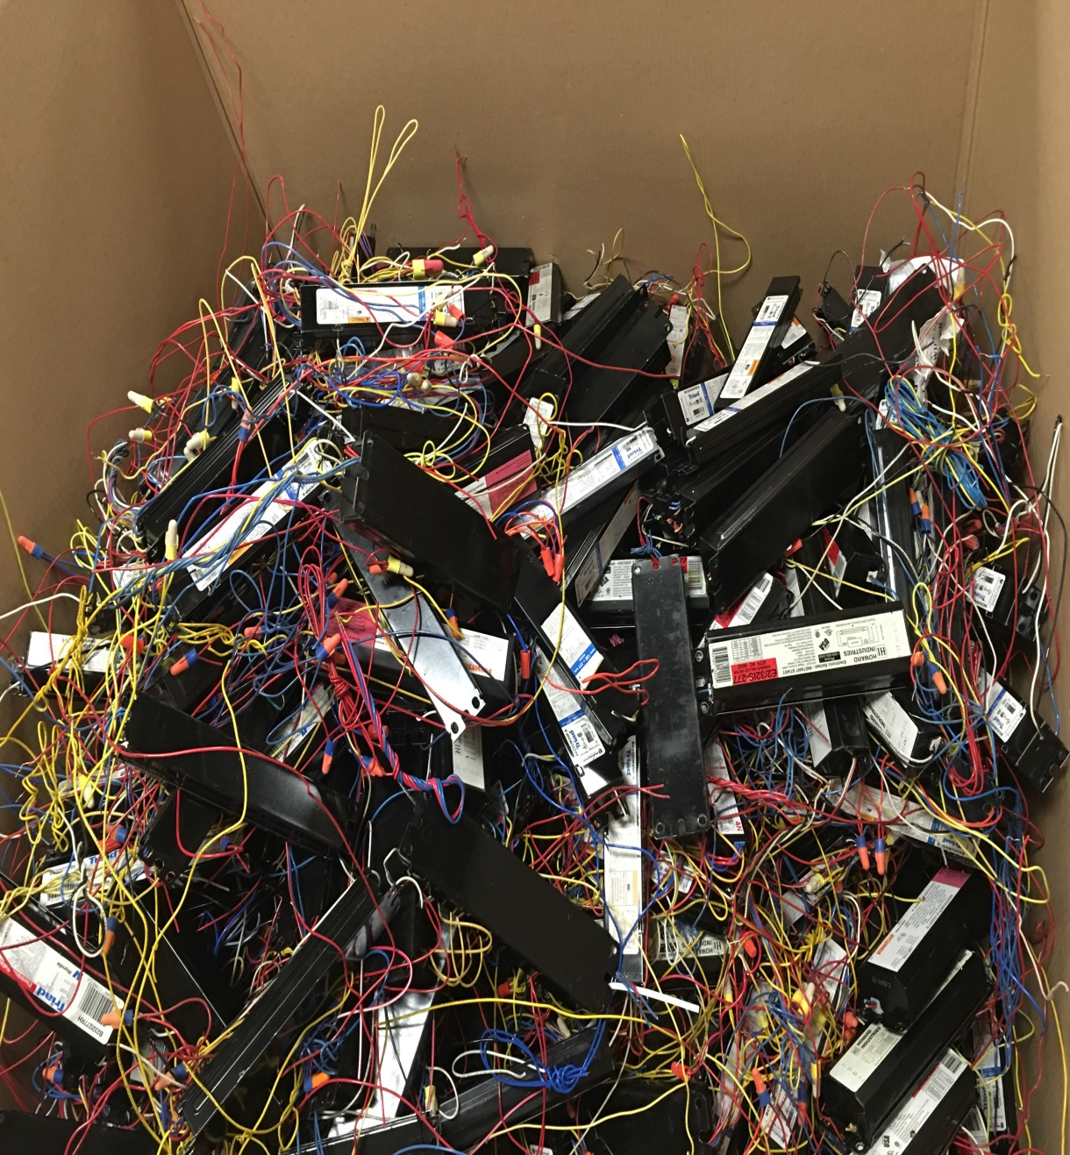
We are replacing 85,000 lamps-50,000 T-8’s and 35,000 LED’s

Slide 8
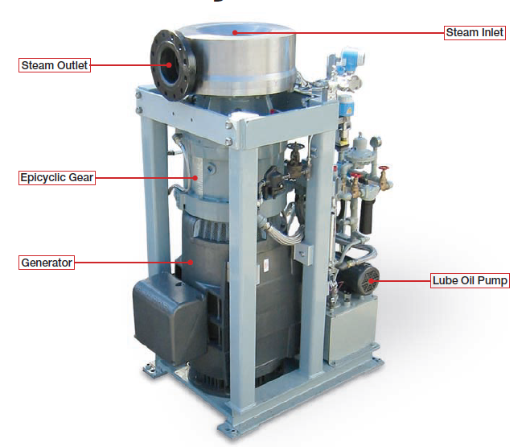
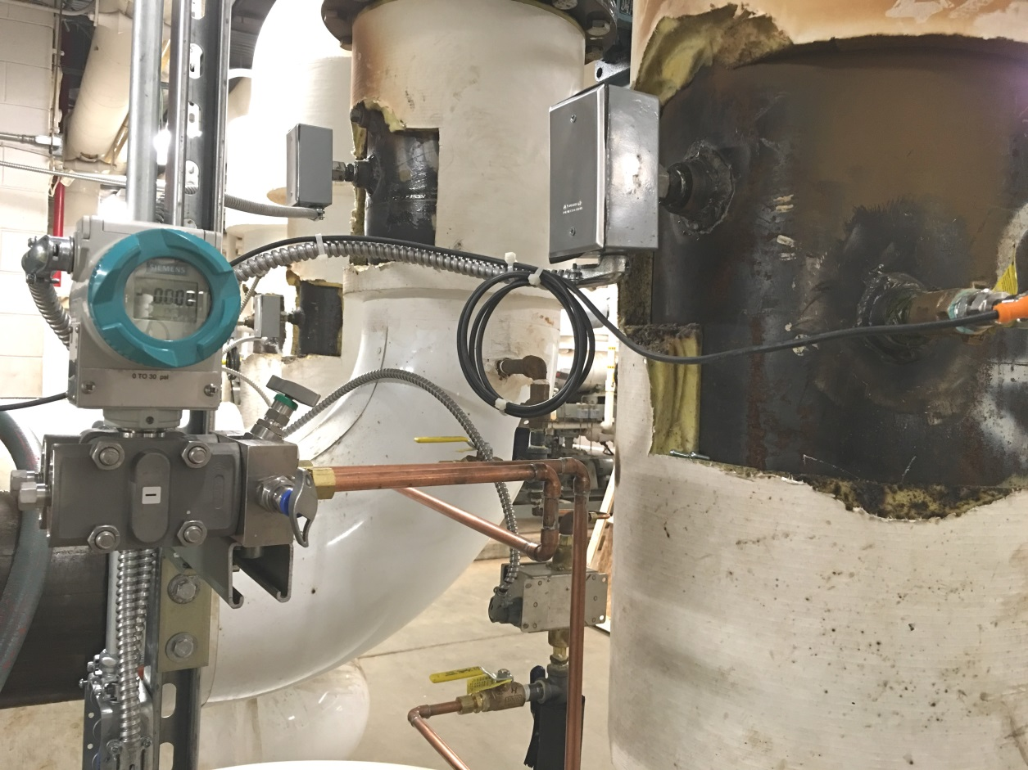
Optimizing our 3300 ton chiller plant and installing Micro steam turbine generator

Slide 9
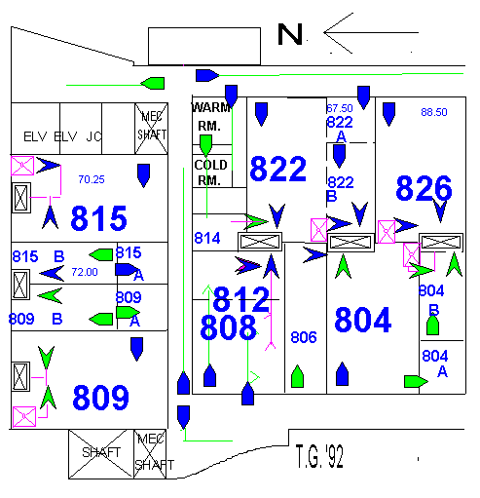
Tying in the lighting occupancy sensors to the Building Automation System

Slide 10
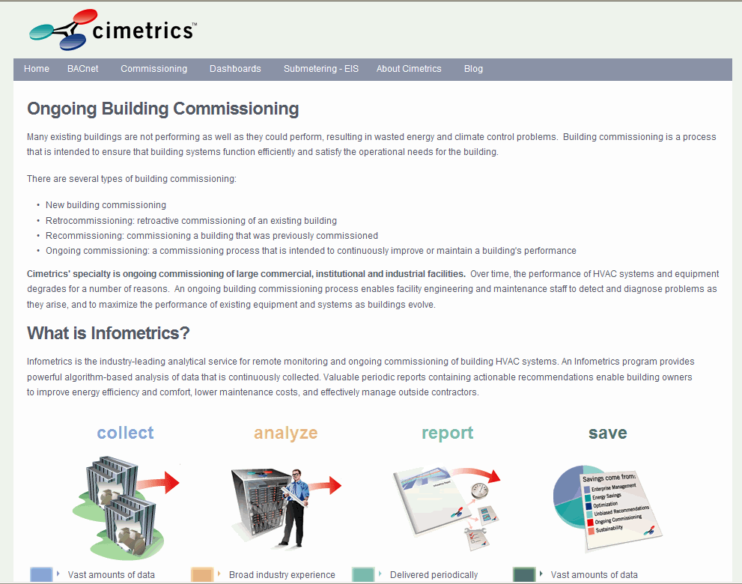

Slide 11
What savings do we expect when this is done?
Reduce our electric consumption by 14,800,000 kWh
Reduce our electric peak by 1,530 kW
Have all new lamps and ballasts with a 3 year (T-8’s) or 5 year (LED’s) warranty
Reduce our steam consumption by 10,700 mmBTU
Reduce our chilled water consumption by 334,000 ton-hrs.
Save $2 million per year
Receive nice big rebate checks from PECO!
Working with a consultant, we are submitting many more smaller projects and putting the money back into more projects.

Slide 12



Questions?
Randolph.Haines@jefferson.edu
phone x3-6099
Thank You

